Slide 1
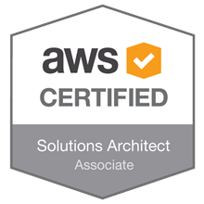
AWS-SA
Amir Khan

Slide 2
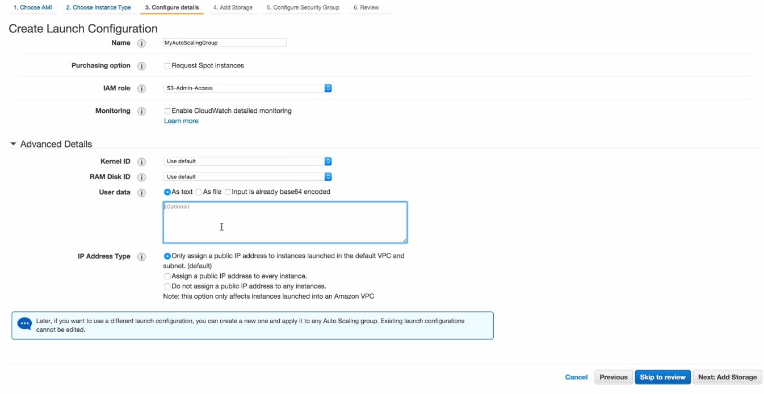
Autoscaling Groups
Autoscaling groups is defining a group that would scale up or down as per the rules defines in that group
In order to setup autoscaling groups we would need a launch configuration
We need to create a healthcheck file, this would be used by the autoscaling group to check the status of the instance
Launch configuration can be found under the EC2 dashboard
It's essentially the same steps that you would do while creating an EC2 instance

Slide 3
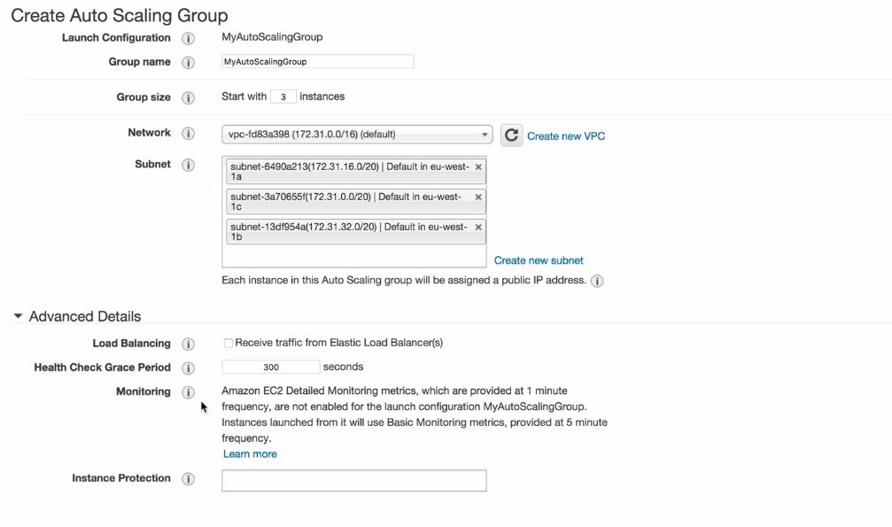
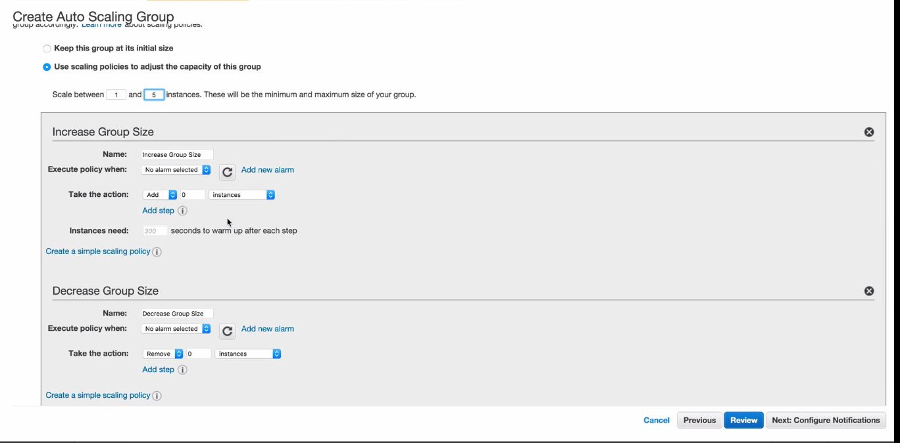
Autoscaling Groups
Once the launch configuration is done it will take us to the auto-scaling option
Group-size :- is the number of instance this autoscaling group would start with
Then select the VPC and then select the AZ
1 autoscaling group can span in one region only
It cannot provision the instance in another region
You can use route 53 and configure failover routing policy in case the entire region is down.

Slide 4
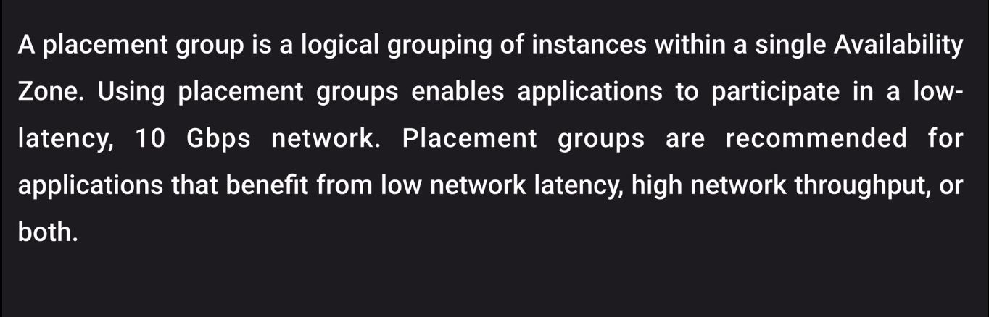
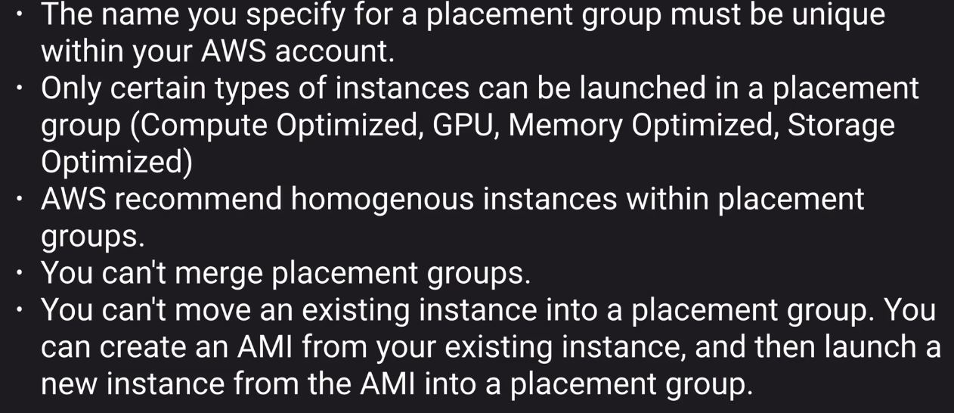
Placement groups
Now placement groups can span multiple AZ few use cases are hadoop cluster
Important key point for placement groups

Slide 5
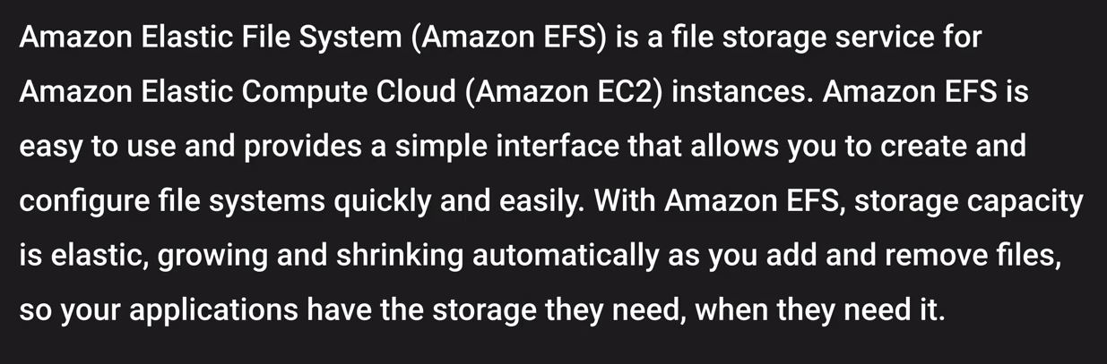
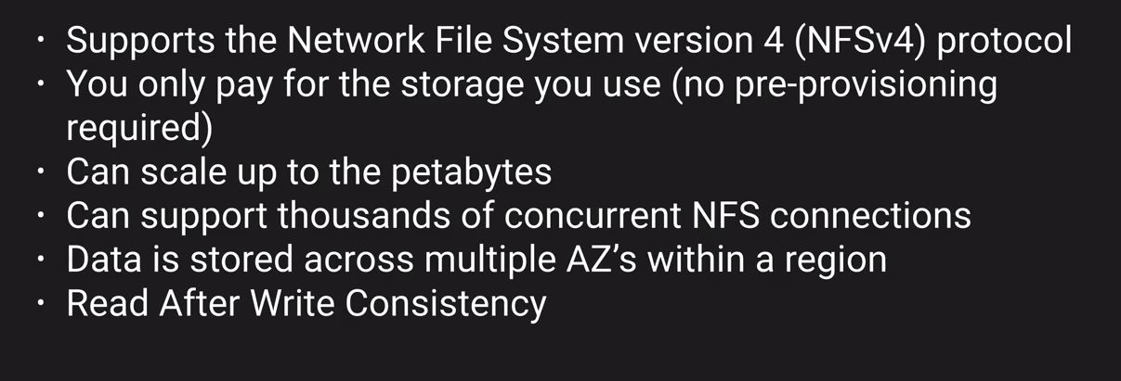
EFS
Basic advantage of efs/ebs is you can mount efs to multiple ec2 instance
You don't pre-provision any storage
EFS Features

Slide 6
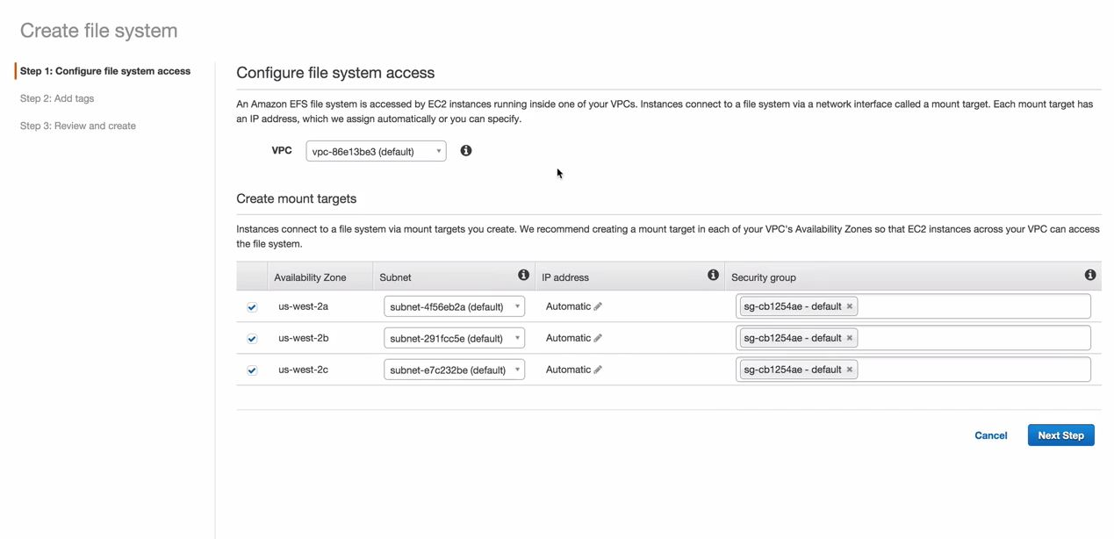
Create EFS
How to attach an EFS to a machine
You have to login to the machine first
In order to test this provision two ec2 instance and then attach EFS to them
Note :- in order to mount efs to an instance the instance and EFS should be in the same SG

Slide 7
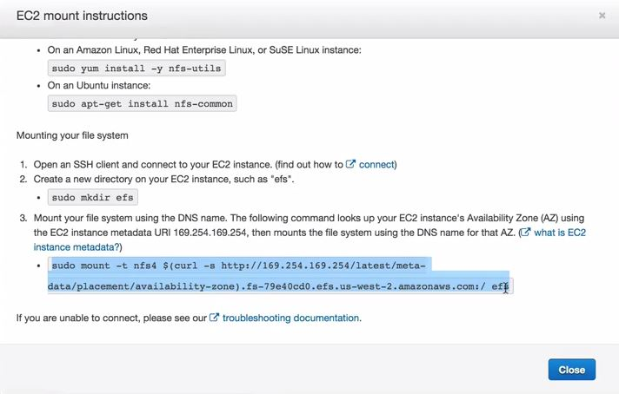
Create EFS
You can also use user level permissions and directory level permissions
Directory level permissions would be same across all the ec2 instance

Slide 8
Route 53
What is DNS ?
DNS is also known as domain name system can be related with your Phone book
If you want to find the contacts you will go to the name and find their contact details
Same goes with DNS as we all know that IP address is the thing that forms the core backbone of networking on how computers talk to each other on intranet as well as on internet
So, in order to make things simpler for humans to interact with different computers DNS came in to existence
DNS resolves computer names into IP address
There are two kinds of IP address
IPv4 and Ipv6
We all know that IPv6 came into being only because IPv4 were depletion
IPv4 has 32 bit of address and IPv6 is 128 bits
IPv6 is supported at the AWS services level and is also supported at the Route 53 service

Slide 9
Route 53
We would often see Dual stack when we would deal with service
Dual stack is nothing it means that the service supports both IPv4 and IPv6
Top level domain name
So if i talk about this with an example.
If you go to google.com, adobe.com
Whatever you see while looking at the name from reverse order after that is called as top level domain
And, the google or adobe is referred to as first level domain name
Top level domain names are maintained by IANA, it maintains a big database of all available top level domain names
In order to remove the duplicacy from first level domain names there needs to be someone to manage it
This is done by Domain registrar

Slide 10
Route 53
Domain registrar are organisation that provide you your domain name example :- Big rock, Go daddy
These domain names provided to you by the registrar are registered with interNic, which enforces uniqueness of domain names over the internet
Each domain name becomes registered in a central database
NS records :- NS records are used by the top level domain service to direct traffic to the content DNS server which holds the authorative DNS records
So in case if you have purchased a domain name from any other registrar then while creating a zone in Route 53 you get NS records and you share these NS records with them which they would utilize in order to route the traffic to your content
A record :- also known as address record. A record is used by a computer to translate the name of the domain to the IP address
A record will be used where you have an IP address
So in order to overcome this we use Alias records which is essentially similar to CNAME
Note :- you cannot use an A record for an ELB as they do not have an IP address

Slide 11
Route 53
TTL :- Time in seconds for which the DNS records would be cached either on the resolving server or on the local PC
So special care should be taken while changing over these names
So before the migration you should reduce the TTL so the PC does not have the old cached entry for the site that is being migrated
CNAME :- Resolve one domain name to another
Essentially what it is saying is you can create a record that would be resolving the same IP address
So rather than you have two A records you can have a CNAME
amir.com can be a CNAME for amir.corp.adobe.com
Alias :- this is a record which AWS has created and it is used with route53
It is similar to CNAME and is used to map resource record set where you do not get an IP address
Example
ELB, S3 buckets that are configured as website

Slide 12
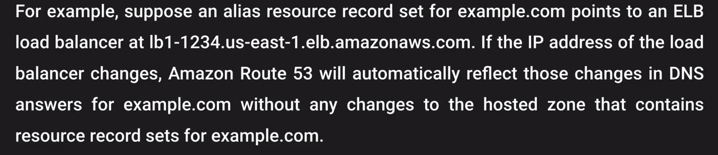
Route 53
Note :- CNAME can't be used for naked domain names. You have to have an A record for naked domain names. naked domain names is nothing but your domain name without www
So as you need an IPv4 address for naked domain names and since with ELB we don't get this we use Alias records
For CNAME you would be charged however for alias record you are not going to be charged for it

Slide 13
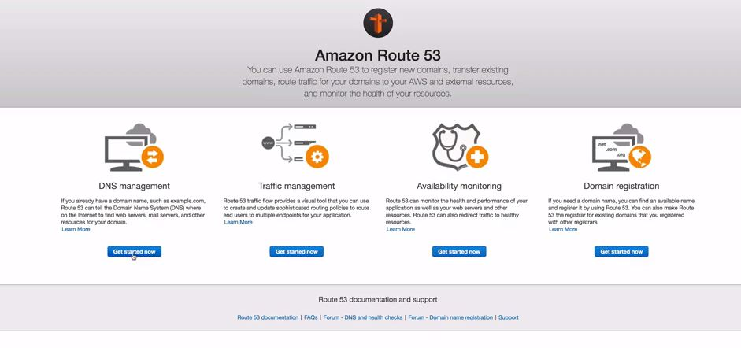
Route 53
How to register a domain name ?

Slide 14
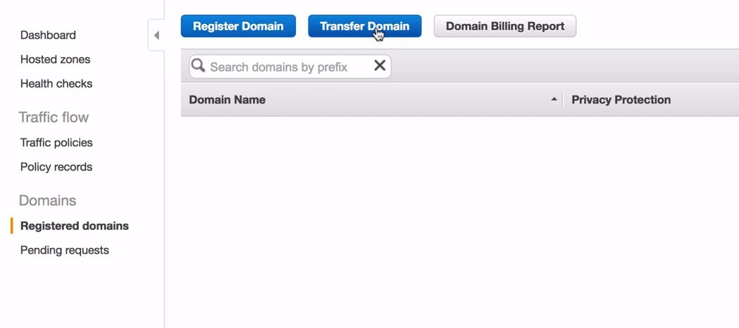
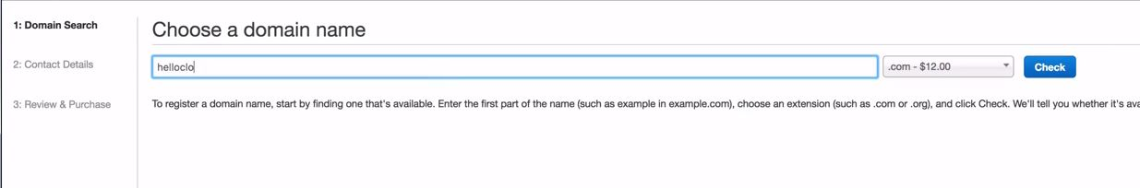
Route 53
How to register a domain name ?

Slide 15
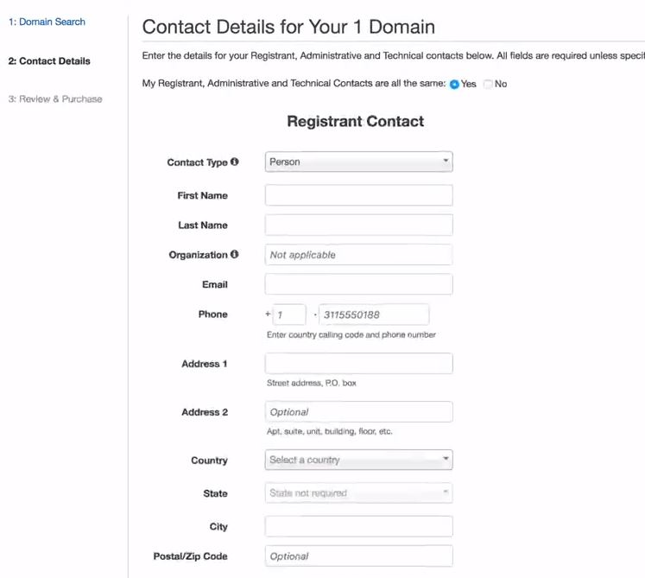
Route 53
How to register a domain name ?

Slide 16
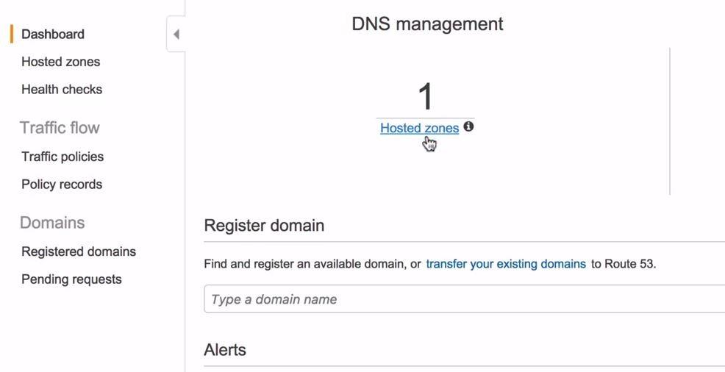
Route 53
Once you have registered your domain it would show you under your registered domains

Slide 17
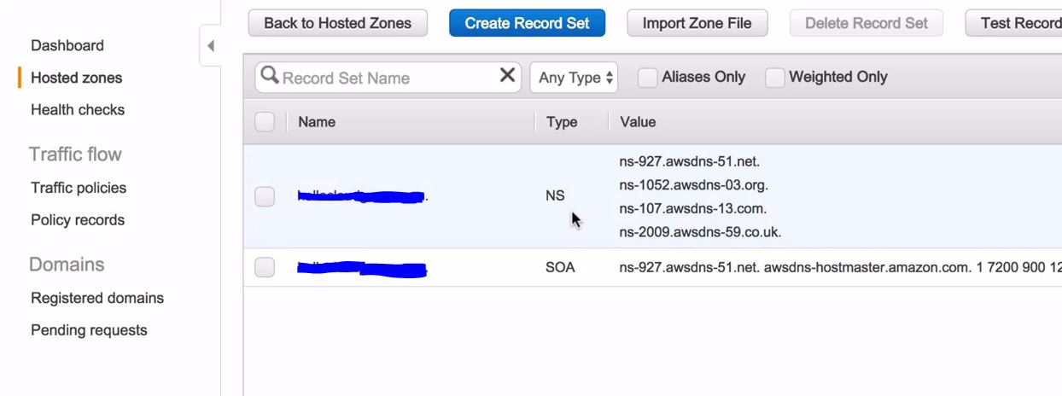
Route 53
Once you are in hosted zones you will find your domain name and once you click on that this would be the screen presented to you

Slide 18
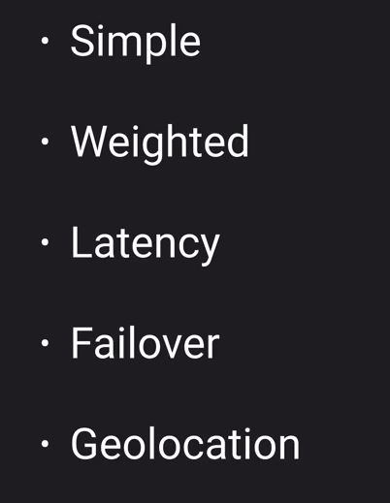
Route 53
So what we can do we can get two instances and create two webservers with the same content
Now we will create a load balancer and would put this behind the load balancer as we did in our last lab
We can also create same setup in a different region
We can create alias records to point to our load balancers in different regions
There are 5 different types of routing policies

Slide 19
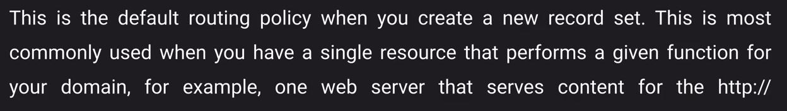
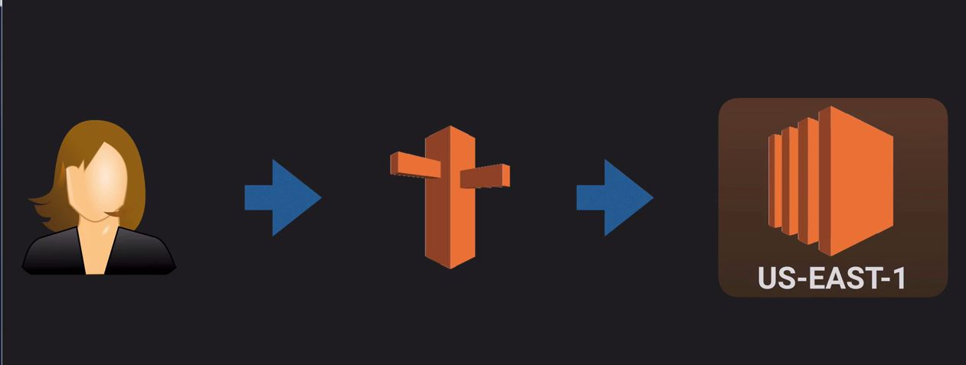
Route 53
Simple routing policies

Slide 20
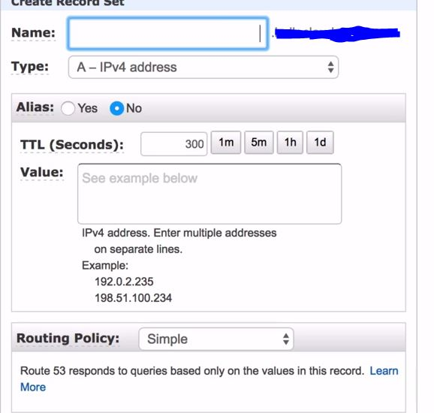
Route 53
In order to set this up
We have to go to the hosted zones
Create a record set for alias

Slide 21
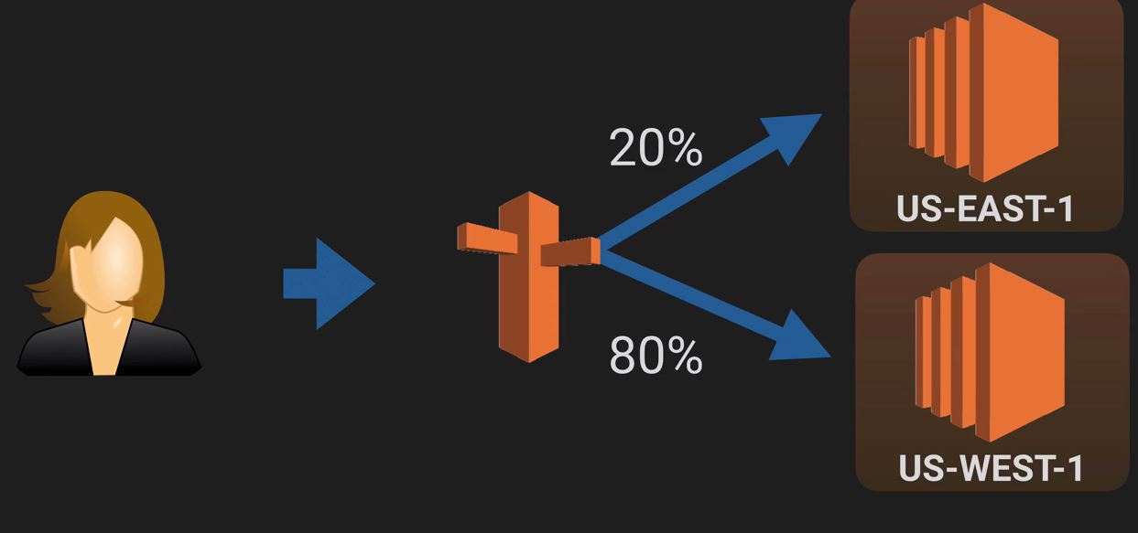
Route 53
Weighted routing
You can use weighted routing where in you can define routes based on a weight given to the record
It needs not be two different regions it can be done for two instances within the same regions or two LB within the same region

Slide 22
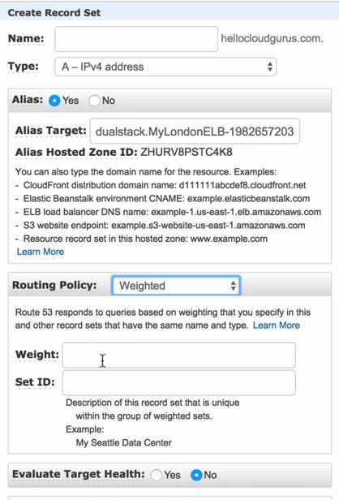
Route 53
Total weight and the weight that you have given will define the routing
For example
You have given a weight of 3 to one LB and 1 to one LB
That one that has 3 weight will get 75 % of the traffic

Slide 23
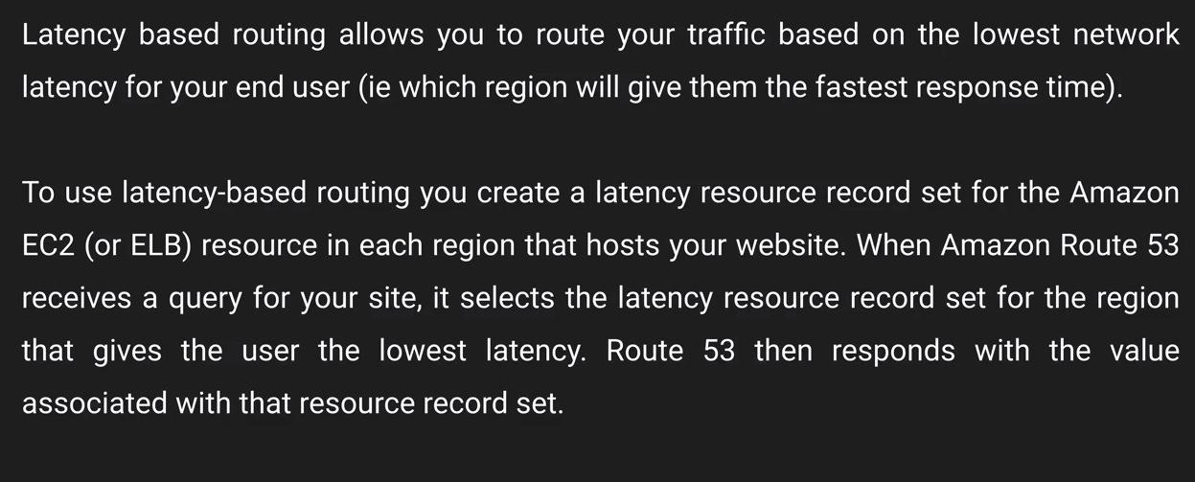
Route 53
Latency routing policies
It routes the traffic based on the lowest latency for end users

Slide 24
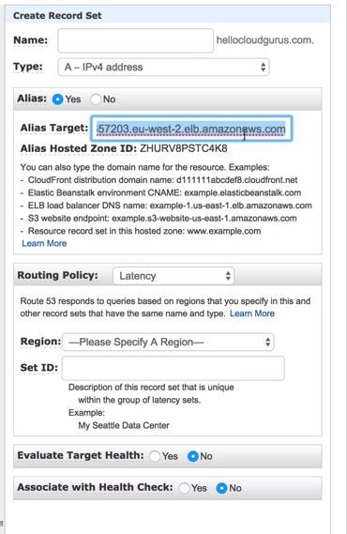
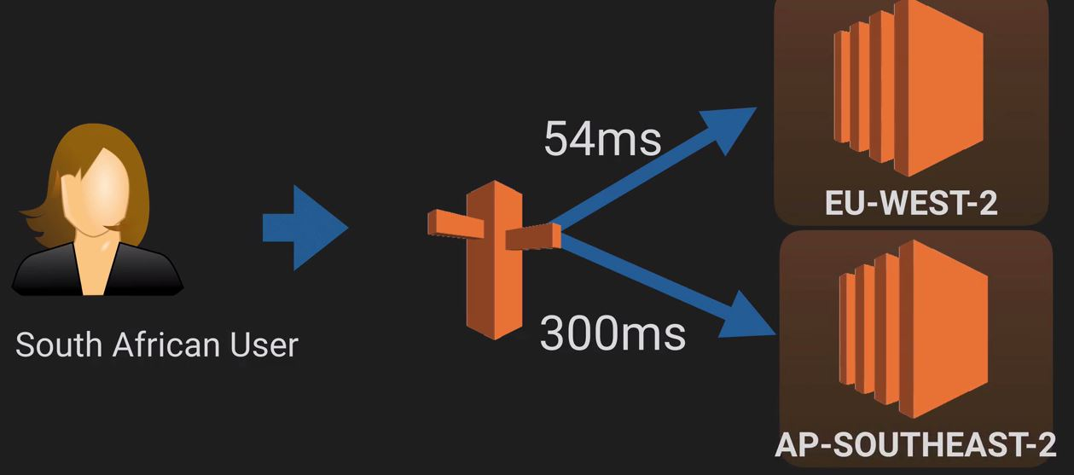
Route 53
Latency routing policies
Based on the latency for an end user traffic would be routed to that region.

Slide 25
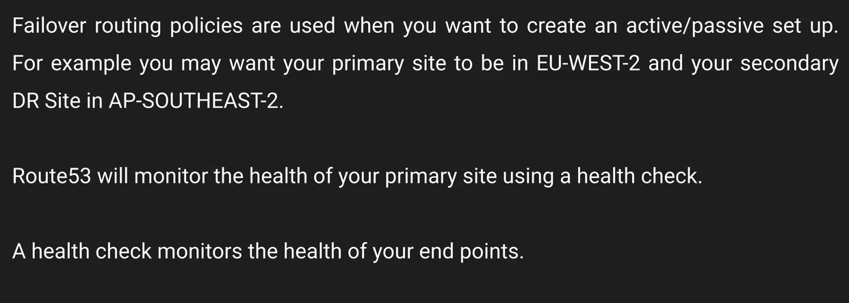
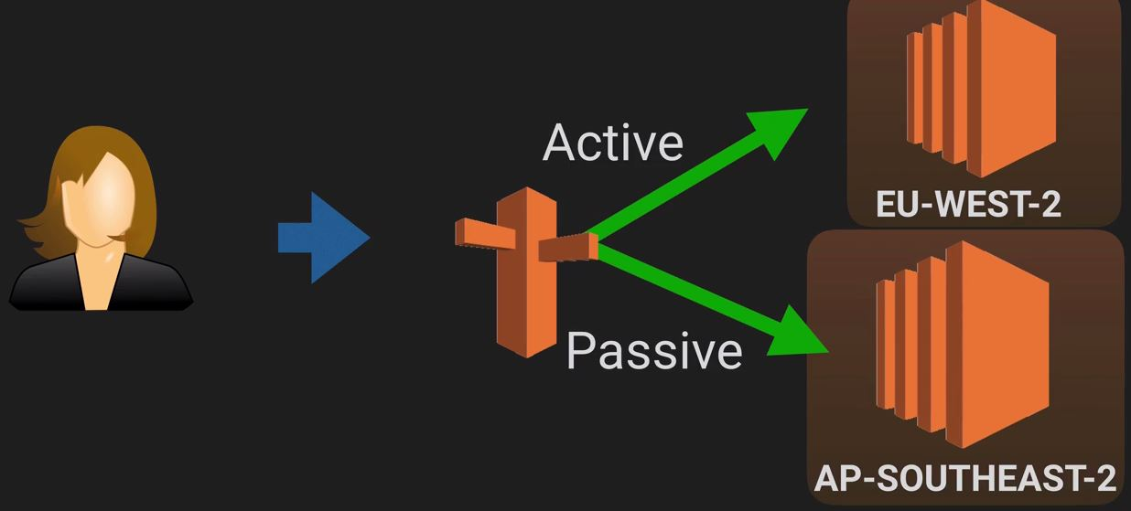
Route 53
Failover routing policy

Slide 26
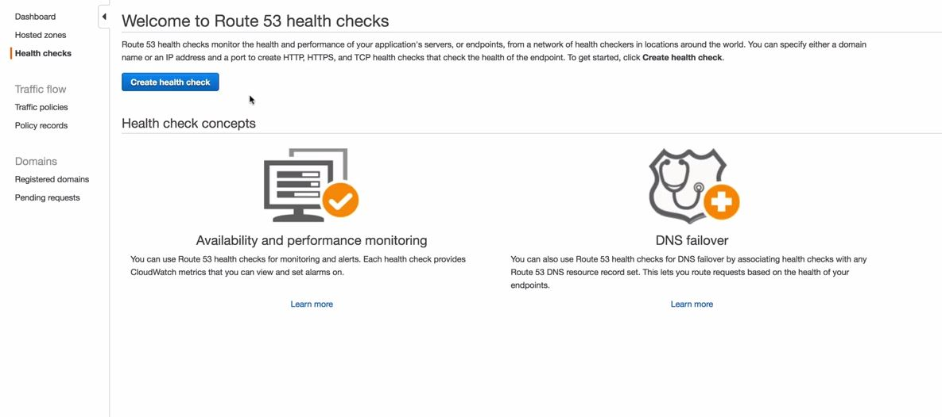
Route 53
Failover routing policy
For Failover we have to configure healthchecks and based on this healthcheck traffic would be routed to the DR site

Slide 27
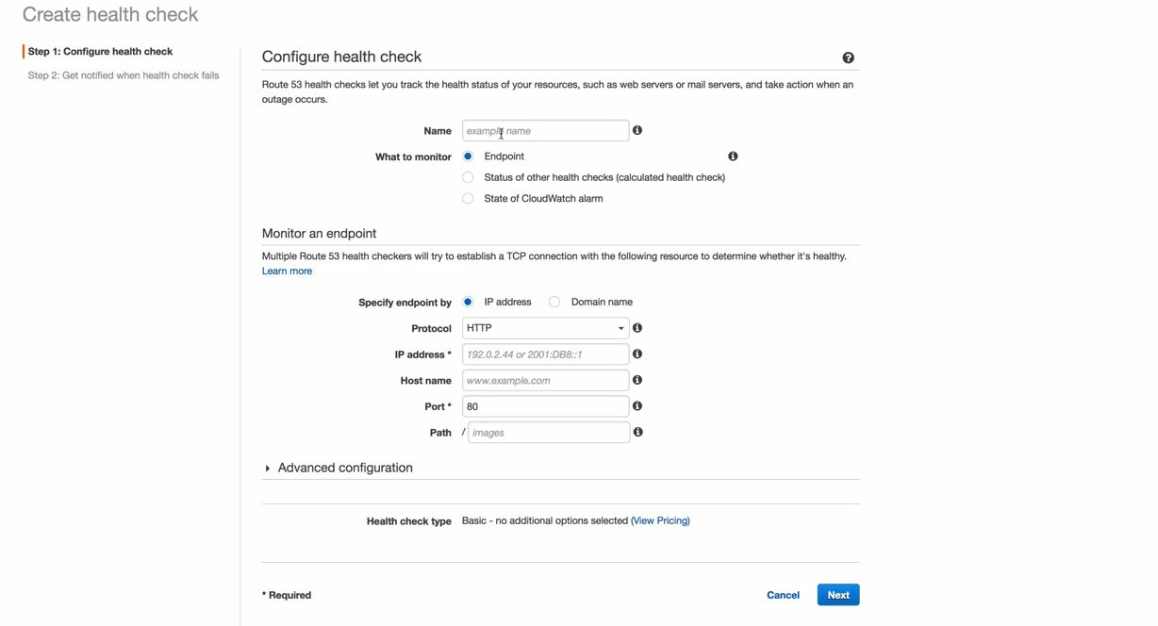
Route 53
Failover routing policy
For Failover we have to configure healthchecks and based on this healthcheck traffic would be routed to the DR site
Note :- You cannot associate a health check to check the same domain name as the record which you have configured in the healthcheck

Slide 28
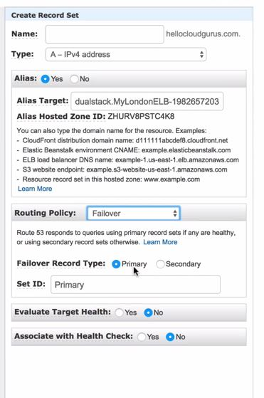
Route 53
Failover routing policy
You can configure alarms in order to send notification in case the health check fails

Slide 29
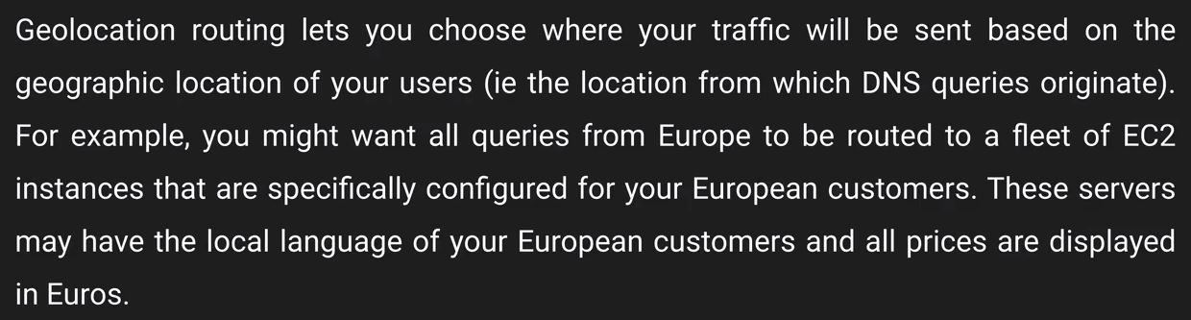
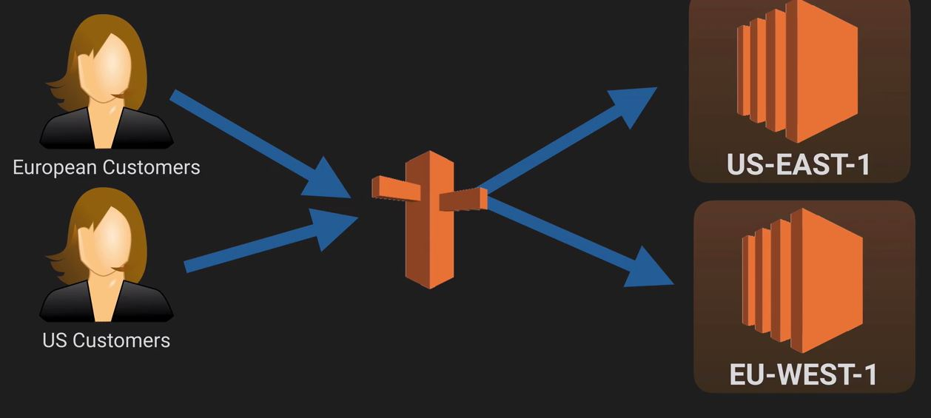
Route 53
Geo-location routing

Slide 30
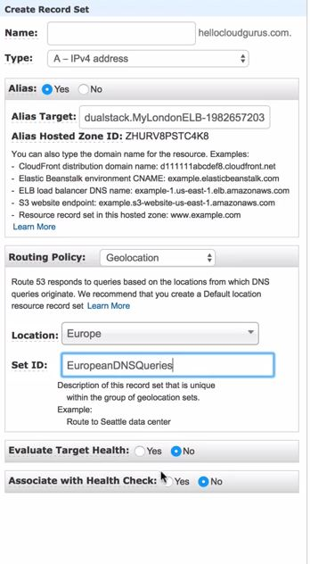
Route 53
Geo-location routing

Slide 31
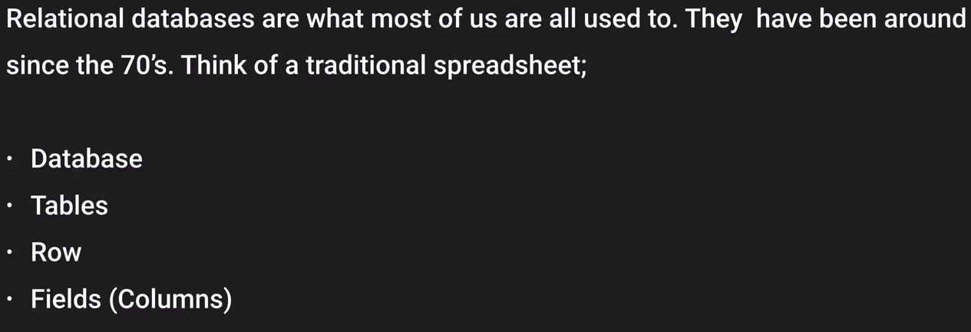
Databases
RDS → Relational Database services
Relational Database is like a spreadsheet
Name of the spreadsheet is like the name of the database
Tables can be related to the number of workbooks
Inside your tables/workbooks you have your rows and columns

Slide 32
Databases
RDS → Relational Database services
Each row is essentially a record
Each field contains the same type of data. Id :- will always be a number, First name :- will always be a string
RDS Database types
SQL server
MySQL Server
Oracle
Aurora
PostgreSQL
MariaDB

Slide 33
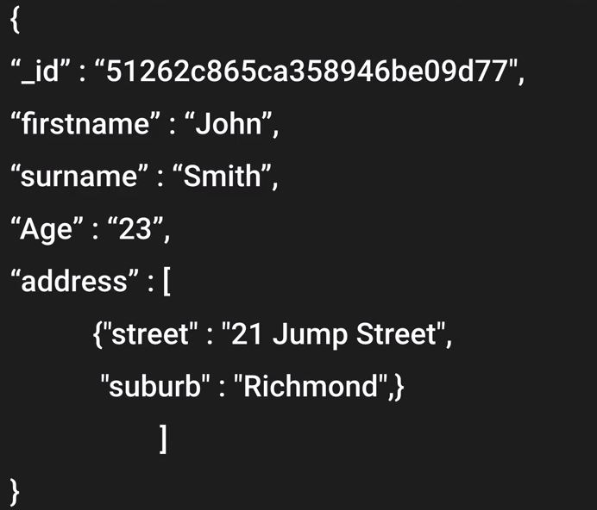
Databases
Non Relational Database
Example :- MongoDB. Couche DB
In Non relational database you have got your database and inside you got your collection
Collections can be referred to as tabled or workbooks
Tables consist of documents which are generally a record set or rows in your table
Key Value pairs :- fields within that table
With no SQL database you start a document with curly brackets

Slide 34
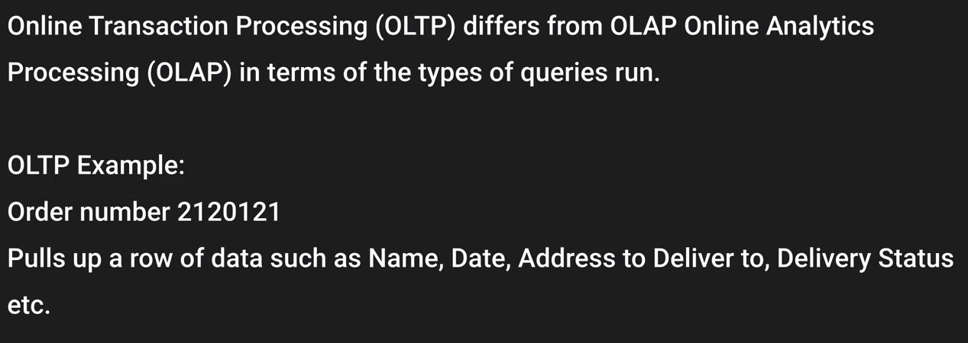
Databases
Data Warehousing
It is used for BI. It is used to pull in very large complex datasets and is used by management to find out profits
There are two different types of processing OLTP and OLAP
With OLTP it hits the database very lighty as when the queries is run there is just one resource record set that is being pulled

Slide 35
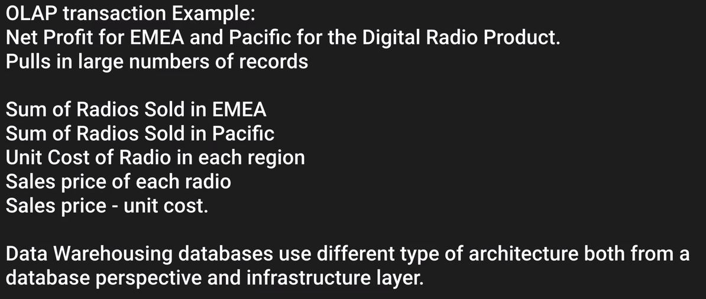
Databases
Data Warehousing
OLAP
As you can see that there is huge amount of data involved hence it would be hitting the database very hard
Hence for data-warehousing a copy of your production database is created and management runs their queries on it

Slide 36
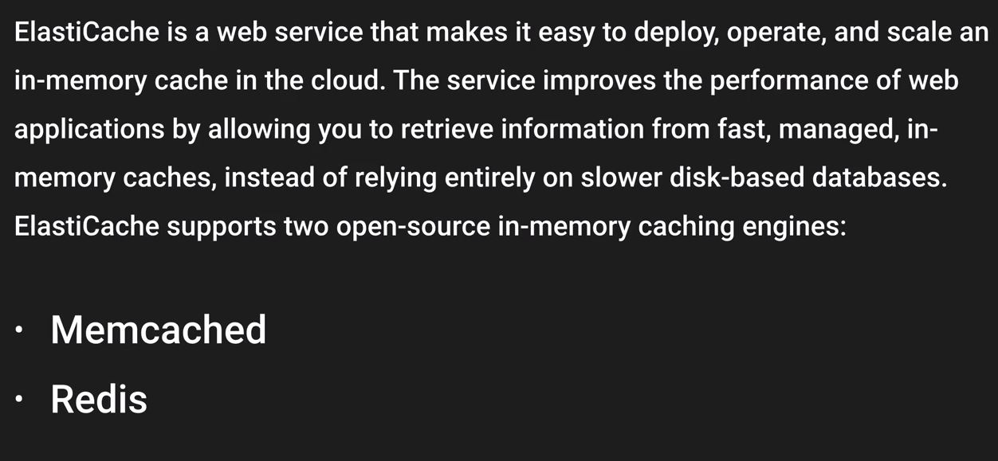
Databases
ElastiCache

Slide 37
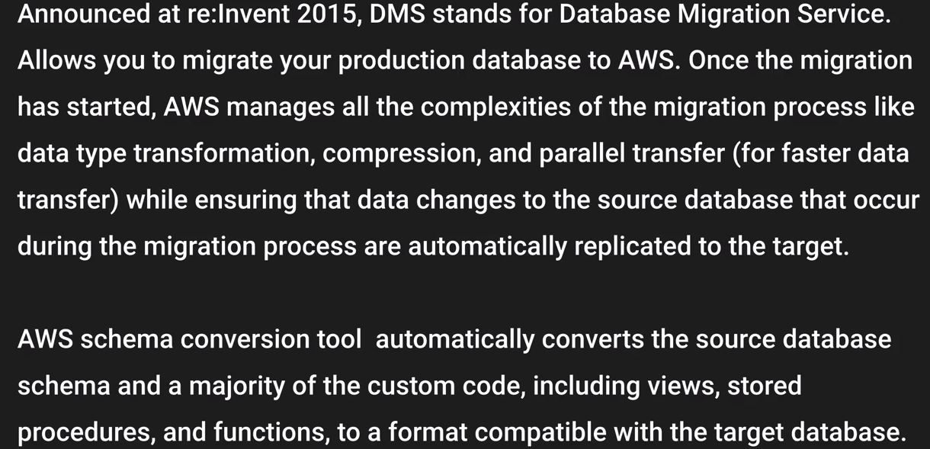
Databases
DMS
NOTE :- RDS is used for OLTP

Slide 38
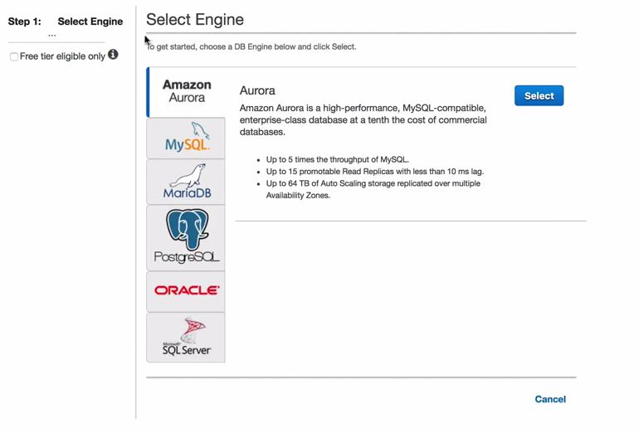
Databases
Let's create our first RDS instance
We will create a webserver and RDS instance and we will put them in two different SG and then we will connect our web server to our RDS instance
Navigate to Database and navigate to RDS and click on get started
Select the engine

Slide 39
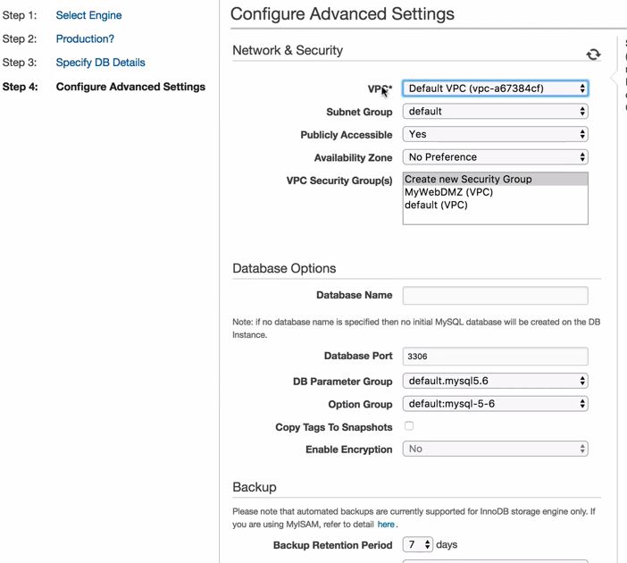
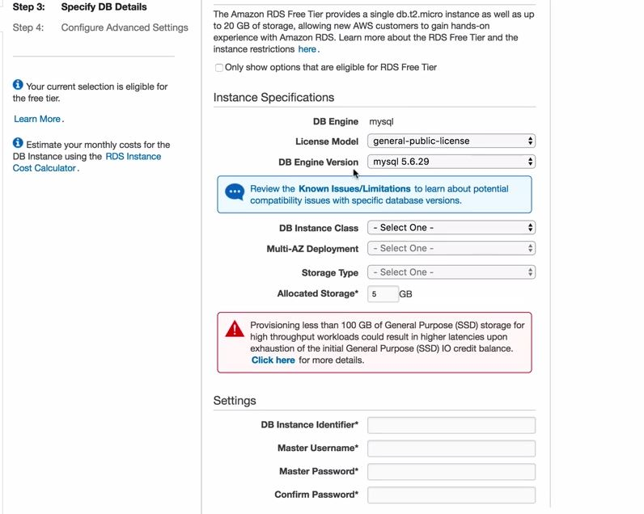
Databases
Let's create our first RDS instance
Select MySQL and choose dev and test

Slide 40
Databases
Let's create our first RDS instance
Leave everything as default and launch the instance
Check the SG that was created by the launch wizard
Change the Security group to allow connections from the SG in which you have your webserver in
Create Connect.php in any S3 bucket you can get the code from git account
https://github.com/Amir345/git2/tree/master/AWS
Launch a webserver and you will get the scripts from the git account
Once done try to check if your webserver is live
Try to check if you can connect to mysql by going to IP address/connect.php
If not edit the file for connect.php

Slide 41
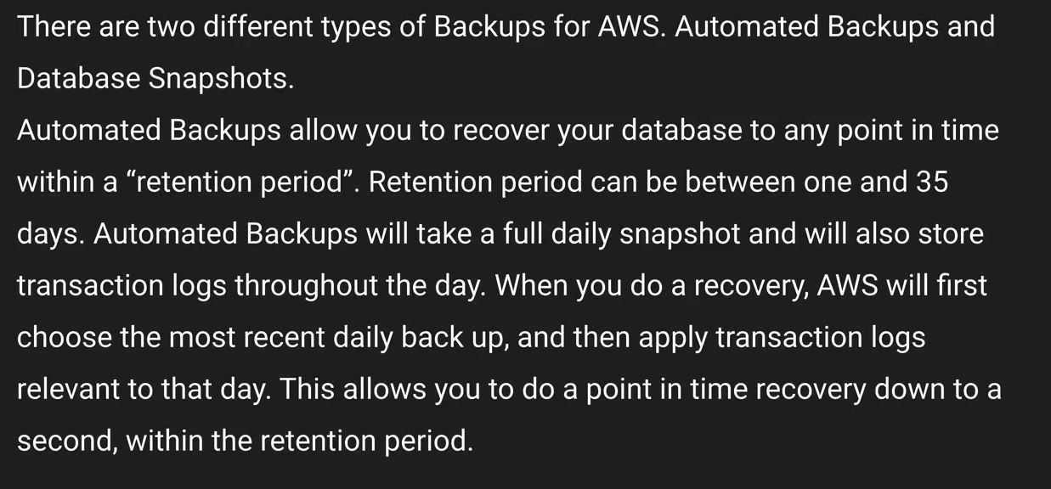
Databases
Let’s try to create a failover
Delete the security rules and it should fail to connect to DB
RDS- Backups-read replicas and Multiple AZ
Backups

Slide 42
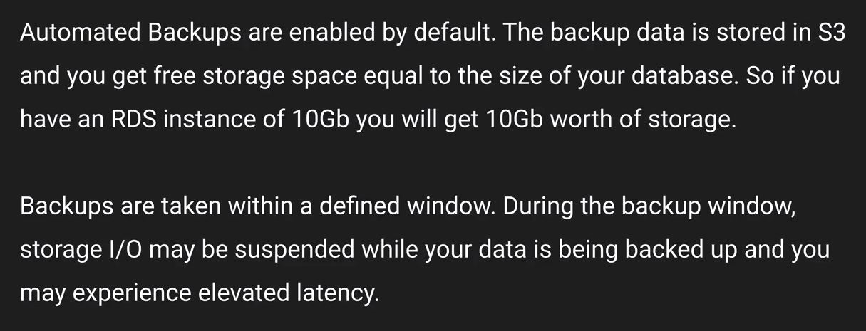
Databases
Automated backups
Snapshots are done manually you have to go to the console and do it and even after you delete the instance these manual snapshots will be retained wherein with automated backups it will be deleted

Slide 43
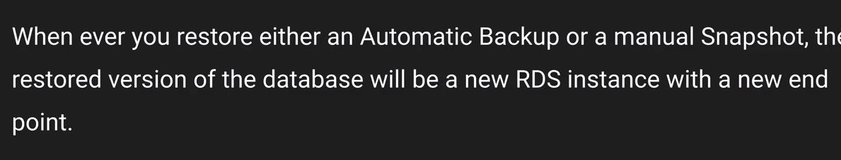
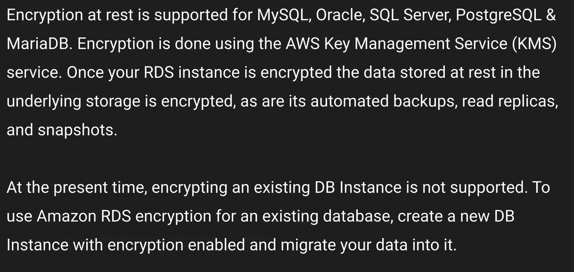
Databases
Restoring backups
Encryption

Slide 44
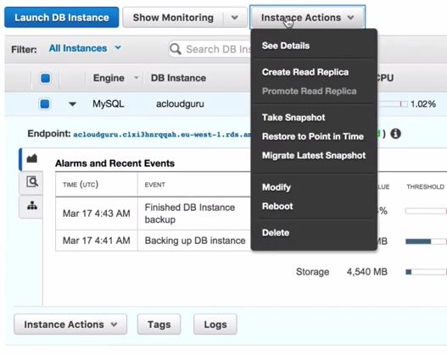
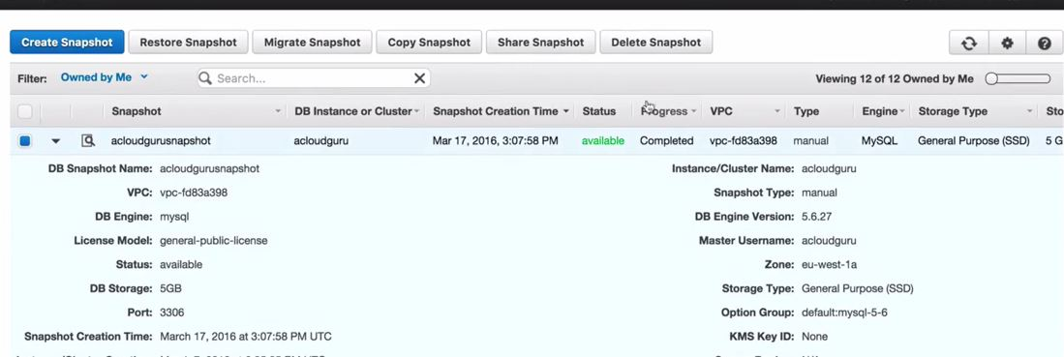
Databases
Creating Snapshot
In order to restor for point in time it is done using instance actions where if we restore the snapshot that would restore the full snapshot
What all actions you can do on a snapshot

Slide 45
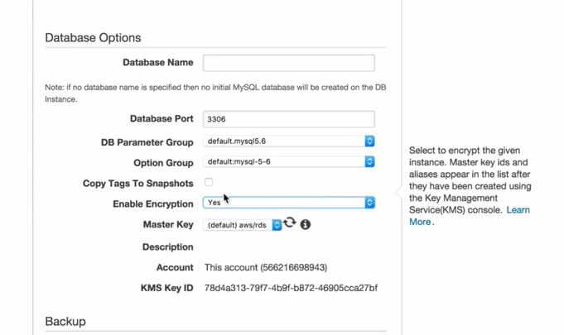
Databases
What all actions you can do on a snapshot
We can migrate the engine, you cannot change the instance class
We can also copy it another region and we can restore it on another region
Note :- while restoring you can scale up the db instance class
Encryption option only comes when we use prod

Slide 46

Databases
Multi -AZ
Multi-AZ is for DR purpose and it synchronously back up your production databse in another AZ and in case of maintainance or faqlure it would fail automatically to the db in another AZ and you don't have to change the endpoint

Slide 47

Databases
Multi -AZ

Slide 48

Databases
Multi -AZ
Supported database for multi-az
Note :- Aurora has multiple copies by default in different AZ

Slide 49

Databases
Read-Replicas
Read-replicas uses asynchronous replication and it creates an exact copy and your instance can read from this copy by changing the connection strings on your instance by pointing the connection to read-replicas

Slide 50

Databases
Read-Replicas
You can even promote these read-replicas as a standalone DB instance
You can create read-replicas of read-replicas and you can have 5 database read-replicas of your origin instance

Slide 51
Databases
Read-Replicas
Read-replica database engines that are supported are
MySQL server
PostgreSQL
MariaDB
Note :- you must have automated backups turned on in order to create read-replicas
You cannot have multi-az turned on read-replicas
However you can create read-replicas of multi-az source database
You can create read-replica in a different region that is only for MySQL and Maria DB
While creating read-replica you can increase the size of the instance and you can change the AZ for your read-replicas
Note :- In order to scale up in RDS its a lengthy and tedious process, although you can scale up in terms of reads using read-replicas. While with Dynamo DB you get push scaling.

Slide 52


Databases
DynamoDB
Note :- stored across 3 different geographical DC does not means three different AZ it essentially is 3 different facilities

Slide 53

Databases
DynamoDB
Eventual Consistent Reads
Consistency across all copies of data within one second
Strongly consistent reads
If your app needs consistency for reads less than a second

Slide 54

Databases
DynamoDB
Note :- You are charged on storage and the throughput capacity
that means you are billed on read capacity units and write capacity units
Note :- With read capacity you are billed for blocks of 50 and for write you are billed for blocks of 10
How to create a DynamoDB table ?

Slide 55

Databases
How to create a DynamoDB table ?

Slide 56


Databases
How to create a DynamoDB table ?

Slide 57


Databases
DynamoDB
Items are nothing but row or resource record set in a table
With DynamoDB you can start creating documents dynamically, as this is a NoSQL database

Slide 58

Databases
DynamoDB
Dynamo DB offers push button scaling while with RDS you have to create read replicas or create a snapshot and create another instance
While dynamo DB is scaling there is no downtime
Redshift

Slide 59
Databases
Redshift
Redshift works on the concept of OLAP wherein large data is involved and that involve complex queries
Data warehousing is all about columns it's not about different resource record sets while it generally works on columns wherein the data in the columns would be added
Note :- Data warehousing uses different types of architecture both from the database perspective or an infrastructure layer
Redshift configuration
You can start with single node with 160 GB
You can also start Multi node configuration
It consist of a leader node which manages client connections and receive queries
And there is compute nodes(128 in number) which will store the data and perform queries and computation on that data)

Slide 60

Databases
Redshift
Columnar data storage

Slide 61

Databases
Redshift
How actually it works
when you do a column query based on particular columns it would only use the data on that and redshift stores this data sequentially
Advance Compression

Slide 62

Databases
Redshift
Why this is successful with redhshift
consider an example for an RDS wherein different types of data is stored sequentially so essentially when you are compressing different types of data it is little bit difficult
However while with redshift it stores columnar data sequentially so it is easy to compress
The other thing that make redshift fast is MPP

Slide 63


Databases
Redshift
Pricing
Encryption
Note :- redshift is a BI tool hence we don't need it for DR it is just available in 1 AZ and you can restore snapshots to new AZ in the event of an outage

Slide 64


Databases
ElastiCache

Slide 65


Databases
ElastiCache
Note :- with Redis you get multi AZ but with Memcached you do not get that

Slide 66

Databases
Aurora
Aurora is the managed version of MySQL from Amazon
It's available in RDS section. It's not something that you can download and install it on your physical server

Slide 67

Databases
Aurora Scaling
It starts with 10 GB and it scales in 10 Gb with increments to 64 Tb
Note :- when you scale aurora it takes only couple of minutes and it's not push button scaling

Slide 68

Databases
Aurora Redundancy

Slide 69


Databases
Aurora Replicas
Note :- In case of failure automatic failover would happen with Aurora replicas
Aurora is not free hence we will not do this lab
How to launch an Aurora instance ?

Slide 70


Databases
How to launch an Aurora instance ?

Slide 71
Databases
How to launch an Aurora instance ?
Failure can be done till tier 15 wherein tier 15 has the lowest priority as aurora can have 15 replicas
In case we enabled multi-AZ this would have launched two instances one is the master and the other one as replica in other AZ
Note :- we have 6 copies of data across three AZ however Aurora runs off a single VM and in case VM fails our database goes down 6 copies relates to different storage medium it does not means that we have 6 instances on which our data is stored
Aurora replicas can be created in a multiple AZ
When you create a replica off master the master becomes writer and then replica becomes the reader

Slide 72

Databases
How to launch an Aurora instance ?

Slide 73
Databases
How to launch an Aurora instance ?
You always use cluster end point in your DNS conenction as it will failover to available instance
We can also do a manual failover

Slide 74

VPC → Virtual private cloud
VPC is really important and you must know in and out of VPC in order to pass the exams
It's your own virtual private DC in the cloud
Every region has a default VPC in every region

Slide 75

VPC → Virtual private cloud

Slide 76

VPC → Virtual private cloud

Slide 77

VPC → Virtual private cloud
How does a VPC looks like

Slide 78

VPC → Virtual private cloud
Internet gateway :- is a gateway that would provide access to internet from your VPC
We have SG in our subnets
Security groups can be attached to different subnets.
The largest that we can have /16 CIDR
You cannot have more than 5 VPC in a region that is the soft limit
The smallest CIDR that you can have for a subnet is /28. That would give you 16 valid IP address
Note :- 1 Subnet = 1 AZ

Slide 79

VPC → Virtual private cloud
We can create subnets and each subnets will go in different AZ.
Subnets should have different N/W address
What else you can do with a VPC ?
You can use private subnets to restrict internet access
Note :- You can only have one IGW with a VPC

Slide 80


VPC → Virtual private cloud
What is the difference between custom and Default VPC ?
VPC Peering

Slide 81

VPC → Virtual private cloud
You can use private subnets to restrict internet access
VPC Peering (Star connection)

Slide 82

Let’s Create our own custom VPC
Let's go to networking and CDN

Slide 83

Let’s Create our own custom VPC
We can also start VPC wizard but that won't help and we will not learn anything
Now before we start i want you all to have a look on what we have right now with the default VPC
Subnets

Slide 84


Let’s Create our own custom VPC
Route Tables
Internet Gateways

Slide 85


Let’s Create our own custom VPC
Security Groups
We can check what security groups we have
Let’s create a custom VPC now

Slide 86

Let’s Create our own custom VPC
Use 10.0.0.0/16 for CIDR as /16 is the maximum that we can get.
Once the VPC is created you will find that there is no subnet created
You will find that there is one Route table is created and you will find that there is no IGW created
You will find that there would be NACL/SG created for the custom VPC

Slide 87

Let’s Create our own custom VPC
You can create subnets
Note :- US-east-1a can be a different AZ for you as it is for me, however the naming convention remains the same

Slide 88
Let’s Create our own custom VPC
You can define your manual CIDR
Let’s take 10.0.1.0/24 for one of the subnets
This would give you 256 address however you can only use 251 addreess
Create another subnet in a different AZ now
Take CIDR as 10.0.2.0/24
The 5 address that is not shown would be reserved VPC IP addresses
First 4 address and the last IP address is reserved
First one :- Network address
Second one :- VPC router
Third one :- DNS
Fourth one :- Reserved for future use
Last one :- Broadcast address
Note :- Since Broadcast is not supported in VPC that is why it is reserved

Slide 89

Let’s Create our own custom VPC
What essentially we have right now

Slide 90

Let’s Create our own custom VPC
Now we would create an IGW
Once you create it will be detached, then you need to attach it to the custom VPC.
Now as we all know that we already have a route table and the default route table would be allowing our subnets to talk to each other
Note :- In case you don’t explicitally assign any route table to any of the custom subnet these would be associated with the default route table

Slide 91


Let’s Create our own custom VPC
These two diagrams show us the Subnet association with the route table that gets created and the routes

Slide 92

Let’s Create our own custom VPC
Every time you create a new subnet it would be associated to your default route table as long as you explicitally associate that to a different route table
Recommended :- That is why we don't want our default route table to have a way out to the internet as in case if the route table would have a route out to the internet then the new subnet create will automatically have a route out to the internet
This is why we should create another route table which we will do right now

Slide 93

Let’s Create our own custom VPC
Create a route table and associate the custom VPC to that
Next thing what we would do is enable internet access
So in the new route table we will create a route
0.0.0.0/0 and the target as our internet GW

Slide 94

Let’s Create our own custom VPC
What does that means is that any subnet associated with this route would have a route out to the internet
now, let's associate a subnet to the new route table and leave the other subnet associated with the main (default) route table
so what this would do is that any instances launched in this subnet would have a route out to the internet
let's make 10.0.1.0 as public and leaved the other one as private
Note :- By default auto assign public IP address for the custom subnets that you have created will be no
we have to change this for the public subnet as we want a public IP to be assigned

Slide 95

Let’s Create our own custom VPC
Let's create two instances one in private subnet and the other as public subnet
Private subnet instance should be in a different SG

Slide 96

Let’s Create our own custom VPC

Slide 97

Let’s Create our own custom VPC
Let's create a SG and allow traffic from public subnet
Note :- Please make sure that the new SG that you are creating should be in the custom VPC
You can also allow the connection from the SG and you should be able to access it
Let's SSH into the Public server and then try to copy the private key over to the public server and then use the private key to SSH in to the private instance
You should never do that rather use a jumpbox or a bastion host

Slide 98

Let’s Create our own custom VPC
Try to update the server it will not work as this instance is in the private subnet this will not work
To overcome this we use NAT Gateway/NAT instance
NAT instance
Create a nat instance from community AMI and place this in the public subnetthat the new SG that you are creating should be in the custom VPC
Once the machine is created disable the Source and destination check

Slide 99
Let’s Create our own custom VPC
Why do we do this ?
As each EC2 instacne perfomrs Source/Destination checks, this means that the instance must be a source or destination of any traffic it sends or receives
Since we are not doing this that is the reason we disable that.
Once the NAT instance is created, Go to to main or default route and create a route out to the internet via the NAT instance
Now try to update, and this would work
However with NAT instance is just one machine there would be performance bottle necks.
As soon as the envoironment grows this NAT instance will not be able to send out traffic out to the internet. If the instance dies that would be our single point of failure
If the OS fails that would be our single point of failure
We can use autoscaling keep it in Multi AZ have different route out through different NAT instance.
Rather using this we will use NAT-Gateway

Slide 100


Let’s Create our own custom VPC
NAT-Gateway
Nat gateway only works on IPv4 and Egress only internet gateway on IPv6
How to create a NAT-Gateway ? →

Slide 101
Let’s Create our own custom VPC
NAT-Gateway
Make sure that you select public subnet in your custom VPC while creating nat gateway
We would also need an EIP hit create to associate one
NAT gateway takes some time to provision
Once the nat gateway is provisioned we can edit the routes from the main (default) route tabel and edit the rules over there
Rule should be 0.0.0.0/0 and the target should be your NAT gateway
Comparison of NAT instance and NAT Gateway, let's check the documentation on this
Note :- You can use a NAT instance as a bastion server

Slide 102

Let’s Create our own custom VPC

Slide 103
Let’s Create our own custom VPC
You don't have to manage the nat gateway amazon does that for you
And NAT instance are placed behind the SG while Nat gateway are not placed behind a SG
Access Control list
Network ACL what we have right now is the default ACL that was created when we created our first custom VPC and is allowing all traffic right now in and out
Right now both the subnets are associated with it
Rules are calculated in the series of rule #
Let's create a new NACL and deploy it within custom VPC and like SG they can deployed only with one VPC and they cannot span multiple VPC like SG
By default with the default NACL everything is allowed wherein when you create a private NACL everything is denied by default.
Let's create a webserver from our public instance which is in our public subnet
Associate a subnet with this private NACL, associate with the public subnet

Slide 104


Let’s Create our own custom VPC
Create some rules
What are Ephemeral port ?
Check Wikipedia link for Ephemral port and the amazon documentation for Ephemeral port

Slide 105

Let’s Create our own custom VPC
Let's play with NACL now and let's deny the same rule at a higher rule # and you will see that it would work
However if you change the deny rule to a lower rule # this would work as the rules are calculated in a series lowest rule # has the highest priority
Note :- NACL can be associated with multiple subnets what this means is that these can span multiple AZ

Slide 106

Let’s Create our own custom VPC
Note :- Do allow ephemral ports on outbound rules

Slide 107

Let’s Create our own custom VPC
Load balancer and Custom VPC
We will create an Application Load balancer, and we would try to create one within the custom VPC
In order to use the load balancer it should be done within two or more AZ that essentially means two or more subnets.
Make sure that these are public subnets in case you will select a private subnet you will get a warning message
VPC flow logs

Slide 108


Let’s Create our own custom VPC
VPC flow logs
It is essentially monitoring all the network traffic to and fro from your ENI
In order to create a flow log at the VPC level

Slide 109

Let’s Create our own custom VPC
VPC flow logs
You have to create a role for flow log and we have to create a flow log role
We have to create a flow log group and that can be done from cloudwatch

Slide 110


Let’s Create our own custom VPC
VPC flow logs

Slide 111


Let’s Create our own custom VPC
VPC flow logs

Slide 112

Let’s Create our own custom VPC
VPC End points

Slide 113

Let’s Create our own custom VPC
VPC End points
We will create an internal gateway in order to access S3 bucket without traversing the internet
Create a role to access S3 from EC2
Let's bring the subnets to the default NACL
Remove the route from the default route table in which we added our NAT gateway
Now try to SSH in to the public instance and through that go to private instance

Slide 114

Let’s Create our own custom VPC
VPC End points
Choose the gateway and then choose the custom VPC and then after that we have to select the route table which we would select to be the main one as the main route table does not have a route out to the internet

Slide 115

Application Services
SQS :- Simple Queue Service
SQS was the first AWS service that was publically available

Slide 116
Application Services
SQS :- Simple Queue Service
Example
Let's say that you have a website wherein you create and edit photos
Users would upload the photos and photose gets uploaded in S3 and once it is uploaded you can use event to trigger a Lambda function and lambda would be sending the data about the photo to an SQS queue (how the backgroun should be, which bucket it is uploaded to) And this sits in the SQS queue waiting to be processed
You can have a EC2 instance looking for messages
Think of SQS as a service that assign jobs
They would poll the SQS queue to get the message and process
Once message the process it would store it to the relevant bucket location as it is given in the job
Once the job is finished it would again look for jobs from SQS
You can use autoscaling behing SQS queue messaged and it can provision more instances if the queue is large

Slide 117

Application Services
SQS :- Simple Queue Service
Note :- if the EC2 machine got terminated you will not loose the job even tough if that was picked from SQS
So there is a visibility timeout period, in case the job is not processed within the visibility timeout period SQS would show the job again
So, to explain once the job is picked by an agent SQS keeps that job in hidden state and in case the job is process it is deleted in case it is not deleted it becomes visible in the queue again.
Note :- SQS is pull based and SNS is push based
with SQS you are removing dependencies it helps you in decouple the component of an application

Slide 118

Application Services
SQS :- Simple Queue Service
There are two different types of queues
Standard Queues
FIFO Queue

Slide 119

Application Services
SQS :- Simple Queue Service
Standard queues is the default option for SQS

Slide 120

Application Services
SQS :- Simple Queue Service
FIFO
Messages would be sent out in the order in which they were received

Slide 121

Application Services
SQS Important terms
Note :- Please do not use SQS for any job that takes more than 12 hours to process

Slide 122

Application Services
SQS Important terms

Slide 123


Application Services
SWF :- Simple Work Flow

Slide 124


Application Services
SWF :- Simple Work Flow
SWF consist of two parts
Workers and Deciders
What are workers ?
What are Deciders ?

Slide 125

Application Services
SWF :- Simple Work Flow

Slide 126

Application Services
SWF :- Simple Work Flow
SWF Domains
Note :- Maximum workflow can be 1 year and the value is measured in seconds

Slide 127

Application Services
SWF :- Simple Work Flow
SWF vs SQS

Slide 128

Application Services
SWF :- Simple Work Flow
SWF Key terms

Slide 129


Application Services
SNS :- Simple Notification Service
Simple notification is a push based service which is used to send notification out to users

Slide 130

Application Services
SNS :- Simple Notification Service
You can have cloudwatch or an auto scaling event associated with it.
You can use SQS in conjunction with SNS
So SQS would send out messages to SNS and SNS would publish that to subscribers
What it does it adds up on redundancy

Slide 131

Application Services
SNS :- Simple Notification Service
In case your SNS is sending out notification in different format you don't have to change the format for your messages it is done automatically

Slide 132

Application Services
SNS :- Simple Notification Service
SNS Benefits

Slide 133

Application Services
SNS :- Simple Notification Service
SNS vs SQS
SNS is push and SQS polls and both are messaging services in AWS

Slide 134

Application Services
Elastic Transcoder
Every time you upload a vide in S3 bucket in a particular format and then an event can trigger a lambda function to get the video and supply that as an input in Elastic Transcoder and once you transcode it you can supply that to another S3 bucket

Slide 135

Application Services
API Gateway
API Gateway does not generally comes up in the examinations but you may get one or two questions around it

Slide 136

Application Services
Architecture for API-Gateway

Slide 137

Application Services
API-Caching
So to speak about api caching you can cache the response that you recieve from an endpoint that was generated when a requst was made to the endpoint for the very first time.

Slide 138


Application Services
Benefits of API Gateway
Same Origin Policy

Slide 139

Application Services
CORS
Note :- In case you use Javascript wherein that uses multiple domains please make sure to enable CORS

Slide 140


Application Services
Kinesis
Kinesis works on streaming data. examples :- Social media feed, GPS data and Stock prices

Slide 141

Application Services
Kinesis
There are three types of kinesis services

Slide 142

Application Services
Kinesis
Kinesis streams
By default data is stored in streams for 24 hours and you can extend that to 7 days
You can have multiple shards in your stream, the number of data that you can have in you stream is generally defined by the number of shards that you have in your stream

Slide 143

Application Services
Kinesis
Kinesis streams
Kinesis Firehose
Note :- You don't have to worry about shards or you don't have to worry about streams, You don't have to get consumers to analyse the data
However you can analyse the data using lambda and store it in S3
Firehose does not retain the data
Once you get the data in firehose it could be send directly to S3 or redshift or you can run computation in that

Slide 144

Application Services
Kinesis
Kinesis Firehose
You don't have to worry about shards and streams if you are using firehose
Kinesis-analytics
Your data is stored in Kinesis Firehose or Kinesis streams and you can run SQL type querying language on this data and then you can store this data in either S3, redshift
Kinesis Lab

Slide 145

Application Services
Kinesis
Kinesis Lab
We will choose a to use it via S3 or we can do that manually as well
https://s3.amazonaws.com/kinesis-demo-bucket/amazon-kinesis-data-visualization-sample/kinesis-data-vis-sample-app.template

Slide 146


Application Services
Kinesis
Kinesis Lab
Use all the default option and then click on create a stack

Slide 147

Application Services
Kinesis
Kinesis Lab
URL is the both the producer and the consumer as well
We can go in EC2 and you would find that there as an EC2 instance is created we can click on Kinesis streams you will find that there is one created over there and you can find the details about that

Slide 148
Application Services
Kinesis
Kinesis Lab
You can check DynamoDB and there are two tables that are created
You can delete the stack and that would delete all the resources that are provisioned by it.
Kinesis is used to consume big data in order to process large amounts of data you use EMR and for BI you use Redshift
Opswork
It's an orchestration service that uses chef and chef consists of recipes to maintain a consistent state across your infra
Chef is a CM tool which is used for configuration management and is oftenly used to run infra as a code

Slide 149

Application Services
Consolidated billing and AWS Organization
It's an account management service
In case if a company has multiple AWS accounts you can have one account as paying account and rest of them attached to it
Consolidated billing is replaced by Organization
Organization
In organization you have a root account and you create OU as per department
You can apply policy at the OU level as well as the AWS account

Slide 150

Application Services
Consolidated Billing
If you use consolidated billing you just get one bill with a breakdown of all the linked accounts
Paying account is independent and cannot access resources in other AWS account wherein linked accounts are also independent

Slide 151


Application Services
Advantages of consolidated billing
You get volume discounts
You just get one bill and you can track charges

Slide 152

Application Services
Advantages of consolidated billing
You can only have 20 linked accounts to one paying account although you can increase that limit too
Billing alerts
When monitoring is enabled to the paying account the billing data for the linked accounts is included
Although you can create billing alerts for individual accounts
Cloudtrail is for per AWS account and is enabled per region
Note :- Paying account should be used only for billing purpose only

Slide 153


Application Services
Although you can consolidate logs from all your AWS account in one bucket
AWS organizations

Slide 154


Application Services
AWS Organizations

Slide 155


Application Services
AWS Organizations

Slide 156

Application Services
AWS Organizations
Once you invite an account that would send an email to the root account that you have just entered
Once the owner of that rrot account confirms then that account becomes of a part of this organization

Slide 157

Application Services
AWS Organizations
Once OU is created and we can move account in OU
You can also create a custom policy using policy generator
In order to use policy you have to enable those at the root account first and they you would be able to attach that, also while clicking on the policies you can find out on which all accounts/OU this policy is applied to.
Cross account access

Slide 158

Application Services
Cross account access
You can sign in to the AWS console with one IAM identity and you can switch the console to another user without logging out and logging back in
Steps to do that

Slide 159
Application Services
Cross account access
Let's create a group
Call it tester and apply admin policy to that group
Create a user and add that user to the tester group
Then login using a differnet account
Create an S3 bucket
Choose create your own policy
Copy and paste the code that is uploaded on git
In the code change the arn for the resource as per your arn for the bucket
Create a new role and select cross acount access
Type in the other account # and then attach the policy that allows read write to the s3 bucket
logout of the production account and login to the tester account
go to groups and add an inline policy
choose custom policy and then upload the code again from the git and change the production account id variable to your production account # also the role that is given make sure that the role is exactly the same as that is case sensitive

Slide 160

Application Services
Cross account access
Apply the policy
Use the link to sign in as the user that you created in the tester group
from the account now you can switch roles and supply the information

Slide 161

Application Services
Apply the policy
Use the link to sign in as the user that you created in the tester group
from the account now you can switch roles and supply the information
Resource groups & Tagging
Tags are key-value pairs that are attached to AWS resources

Slide 162


Application Services
Resource groups & Tagging

Slide 163

Application Services
Resource groups & Tagging
You can also use tag editor in order to tags the resources that are not tagged right now
RG helps you to track down your cost and know what resources are being used

Slide 164

Application Services
Resource groups & Tagging

Slide 165

Application Services
VPC Peering

Slide 166

Application Services
VPC Peering
when you use VPC peering it's like they do not go out to interent and they communicate with each other using internal IP address
VPC peering does not work with same CIDR
Transitive peering is not supported

Slide 167

Application Services
VPC Peering
You cannot create VPC peering connections in different regions
Direct Connect
Benefits of Direct connect
Increase bandwidth and increase in reliability

Slide 168


Application Services
Difference between direct-connect and VPN

Slide 169

Application Services
Direct connect connection
It does not involve internet to send your traffic

Slide 170

Application Services
STS

Slide 171

Application Services
STS

Slide 172


Application Services
STS
Note :- you have to develop your own identity brokers

Slide 173

Application Services
STS

Slide 174


Application Services
STS

Slide 175


Application Services
Workspaces

Slide 176

Application Services
ECS
Docker

Slide 177

Application Services
ECS
Docker

Slide 178

Application Services
ECS
Docker

Slide 179


Application Services
ECS
Docker

Slide 180

Application Services
ECS

Slide 181

Application Services
ECS

Slide 182

Application Services
ECS

Slide 183


Application Services
ECS

Slide 184

Application Services
ECS

Slide 185

Application Services
ECS

Slide 186

Application Services
ECS

Slide 187

Application Services
ECS

Slide 188

Application Services
ECS

Slide 189

Application Services
ECS

Slide 190
AWS-SA
Thank You

